Slide 1
Data Mining: Concepts and Techniques (3rd ed.) — Chapter 4 —
Jiawei Han, Micheline Kamber, and Jian Pei
University of Illinois at Urbana-Champaign &
Simon Fraser University
©2011 Han, Kamber & Pei. All rights reserved.
1
Notes:
1

Slide 2
Chapter 4: Data Warehousing and On-line Analytical Processing
Data Warehouse: Basic Concepts
Data Warehouse Modeling: Data Cube and OLAP
Data Warehouse Design and Usage
Data Warehouse Implementation

Slide 3
Basic Concept
Data warehouses generalize and consolidate data in multidimensional space. The construction of data warehouses involves data cleaning, data integration, and data transformation, and can be viewed as an important preprocessing step for data mining.
Data warehouses provide online analytical processing (OLAP) tools for the interactive analysis of multidimensional data of varied granularities, which facilitates effective data generalization and data mining.

Slide 4
Basic Concept…
Many other data mining functions, such as association, classification, prediction, and clustering, can be integrated with OLAP operations to enhance interactive mining of knowledge at multiple levels of abstraction.
Hence, the data warehouse has become an increasingly important platform for data analysis and OLAP and will provide an effective platform for data mining.
Therefore, data warehousing and OLAP form an essential step in the knowledge discovery process

Slide 5
What is a Data Warehouse?
Defined in many different ways, but not rigorously/thoroughly.
A decision support database that is maintained separately from the organization’s operational database
Support information processing by providing a solid platform of consolidated, historical data for analysis.
“A data warehouse is a subject-oriented, integrated, time-variant, and nonvolatile collection of data in support of management’s decision-making process.”—W. H. Inmon
Data warehousing:
The process of constructing and using data warehouses

Slide 6
Data Warehouse—Subject-Oriented
Organized around major subjects, such as customer, supplier , product and sales.
Focusing on the modeling and analysis of data for decision makers, not on daily operations or transaction processing.
Provide a simple and concise view around particular subject issues by excluding data that are not useful in the decision support process.

Slide 7
Data Warehouse—Integrated
Constructed by integrating multiple, heterogeneous data sources
relational databases, flat files, on-line transaction records
Data cleaning and data integration techniques are applied.
Ensure consistency in naming conventions, encoding structures, attribute measures, etc. among different data sources
E.g., Hotel price: currency, tax, breakfast covered, etc.
When data is moved to the warehouse, it is converted.

Slide 8
Data Warehouse—Time Variant
The time horizon for the data warehouse is significantly longer than that of operational systems
Operational database: current value data
Data warehouse data: provide information from a historical perspective (e.g., past 5-10 years)
Every key structure in the data warehouse
Contains an element of time, explicitly or implicitly
But the key of operational data may or may not contain “time element”
Example

Slide 9
Example of time variant
A RND department have manager M.Saeed
He has been transferred to Finance department
The incoming manager for RND is A.Sammad
Here in data warehouse we will not update the record but keep it as it is and
we will indicate the M.saeed was manager from 2004 to 2006 and
From 2007 till to date A.Sammad is manager
In such a way we keep the data with respect to time

Slide 10
Data Warehouse—Nonvolatile
A physically separate store of data transformed from the operational environment
Operational update of data does not occur in the data warehouse environment
Does not require transaction processing, recovery, and concurrency control mechanisms
Requires only two operations in data accessing:
initial loading of data and access of data

Slide 11
Definitions: TPS and Concurrency Control
A transaction process system (TPS) is an information processing system for business transactions involving the collection, modification and retrieval of all transaction data.
Characteristics of a TPS include performance, reliability and consistency.
TPS is also known as transaction processing or real-time processing.
Concurrency control is a database management systems (DBMS) concept that is used to address conflicts with the simultaneous accessing or altering of data that can occur with a multi-user system.

Slide 12
Data Warehouse VS OLTP
Organizations typically collect diverse kinds of data and maintain large databases from multiple, heterogeneous, autonomous, and distributed information sources.
It is highly desirable, yet challenging, to integrate such data and provide easy and efficient access to it.
In contrast the traditional database approach to heterogeneous database integration is to build wrappers and integrators (or mediators) on top of multiple, heterogeneous databases.
When a query is posed to a client site, a metadata dictionary is used to translate the query into queries appropriate for the individual heterogeneous sites involved.

Slide 13
The queries are then mapped and sent to local query processors.
The results returned from the different sites are integrated into a global answer set.
This query-driven approach requires complex information filtering and integration processes, and competes with local sites for processing resources.
It is inefficient and potentially expensive for frequent queries, especially queries requiring aggregations.

Slide 14
Data warehousing provides an interesting alternative to this traditional approach.
Rather than using a query-driven approach, data warehousing employs an update-driven approach in which information from multiple, heterogeneous sources is integrated in advance and stored in a warehouse for direct querying and analysis.
Unlike OLTP Data warehouses do not contain the most concurrent information.

Slide 15
However, a data warehouse brings high performance to the integrated heterogeneous database system because data are copied, preprocessed, integrated, annotated, summarized, and restructured into one semantic data store.
Furthermore, query processing in data warehouses does not interfere with the processing at local sources.
Moreover, data warehouses can store and integrate historic information and support complex multidimensional queries.
As a result, data warehousing has become popular in industry.

Slide 16
OLTP vs. OLAP

Slide 17
Why a Separate Data Warehouse?
High performance for both systems
DBMS— tuned for OLTP: access methods, indexing, concurrency control, recovery
Warehouse— tuned for OLAP: complex OLAP queries, multidimensional view, consolidation
Different functions and different data:
missing data: Decision support requires historical data which operational DBs do not typically maintain
data consolidation: DS requires consolidation (aggregation, summarization) of data from heterogeneous sources
data quality: different sources typically use inconsistent data representations, codes and formats which have to be reconciled
Note: There are more and more systems which perform OLAP analysis directly on relational databases

Slide 18
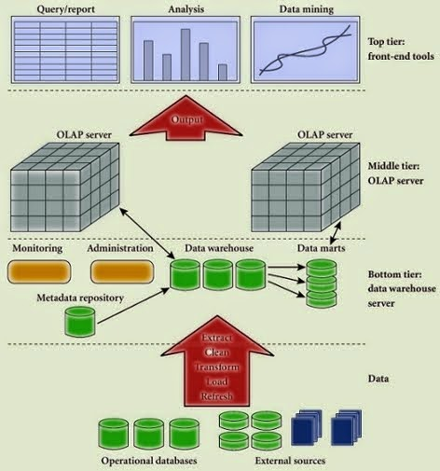
Data Warehouse: A Multi-Tiered Architecture

Slide 19
Data Warehouse: A Multi-Tiered Architecture
Monitor
&
Integrator
OLAP Server
Other
sources
Metadata
Analysis
Query
Reports
Data mining
Operational
DBs
Extract
Transform
Load
Refresh
Data
Warehouse
Serve
Data Marts
Data Sources
Data Storage
OLAP Engine
Front-End Tools

Slide 20
Data Warehouse: A Multi-Tiered Architecture
Bottom Tier - The bottom tier of the architecture is the data warehouse database server. It is the relational database system. We use the back end tools and utilities to feed data into bottom tier. These back end tools and utilities perform the Extract, Clean, Load, and refresh functions.
Middle Tier - In the middle tier we have OLAP Server. The OLAP Server can be implemented in either of the following ways:
By relational OLAP (ROLAP), which is an extended relational database management system, the ROLAP maps the operations on multidimensional data to standard relational operations.
By Multidimensional OLAP (MOLAP) model, which directly implements multidimensional data and operations.
Top-Tier - This tier is the front-end client layer. This layer holds the query tools and reporting tool, analysis tools and data mining tools.
Query and reporting Tools
Analysis Tools
Data Mining Tools

Slide 21
Three Data Warehouse Models
From the architecture point of view, there are three data warehouse models:
The enterprise warehouse,
The data mart, and
The virtual warehouse.

Slide 22
Three Data Warehouse Models…
Enterprise warehouse
collects all of the information about subjects spanning the entire organization.
It provides corporate-wide data integration, usually from one or more operational systems or external information providers, and is cross-functional in scope.
It typically contains detailed data as well as summarized data, and can range in size from a few gigabytes to hundreds of gigabytes, terabytes, or beyond.
An enterprise data warehouse may be implemented on traditional mainframes, computer super servers, or parallel architecture platforms. It requires extensive business modeling and may take years to design and build.

Slide 23
Three Data Warehouse Models…
Data Mart
a subset of corporate-wide data that is of value to a specific groups of users. Its scope is confined to specific, selected groups, such as marketing data mart
Independent vs. dependent (directly from warehouse) data mart
Two categories depends on data source type.
Independent : data collected Locally/one department or geographical area.
Dependent data marts are sourced directly from enterprise data warehouses.

Slide 24
Three Data Warehouse Models…
Virtual warehouse
A set of views over operational databases
Only some of the possible summary views may be materialized
easy to build but requires excess capacity on operational database servers.

Slide 25
Data Warehouse Development: A Recommended Approach
Multi-Tier Data Warehouse
Distributed Data Marts
Enterprise Data Warehouse
Data Mart
Data Mart
Model refinement
Model refinement
Define a high-level corporate data model

Slide 26
Extraction, Transformation, and Loading (ETL)
Data warehouse systems use back-end tools and utilities to populate and refresh their data.
These tools and utilities include the following functions:

Slide 27
Extraction, Transformation, and Loading (ETL)
Data extraction
get data from multiple, heterogeneous, and external sources
Data cleaning
detect errors in the data and rectify them when possible
Data transformation
convert data from legacy or host format to warehouse format
Load
sort, summarize, consolidate, compute views, check integrity, and build indicies and partitions
Refresh
propagate the updates from the data sources to the warehouse

Slide 28
Metadata Repository
Metadata are data about data. When used in a data warehouse, metadata are the data that define warehouse objects.
A metadata repository should contain the following

Slide 29
Metadata Repository
Meta data is the data defining warehouse objects. It stores:
Description of the structure of the data warehouse
schema, view, dimensions, hierarchies, derived data definitions, data mart locations and contents
Operational meta-data
data lineage (history of migrated data and transformation path),
currency of data (active, archived, or purged), and monitoring information (warehouse usage statistics, error reports, audit trails)
The algorithms used for summarization
The mapping from operational environment to the data warehouse
Data related to system performance
warehouse schema, view and derived data definitions
Business data
business terms and definitions, ownership of data, charging policies

Slide 30
Chapter 4: Data Warehousing and On-line Analytical Processing
Data Warehouse: Basic Concepts
Data Warehouse Modeling: Data Cube and OLAP
Data Warehouse Design and Usage
Data Warehouse Implementation

Slide 31
OLAP overview
Data warehouses and OLAP tools are based on a multidimensional data model. This model views data in the form of a data cube.
A data cube allows data to be modeled and viewed in multiple dimensions. It is defined by dimensions and facts.
Dimensions are perspective entities with respect to which an organization wants to keep records.
Fatcs like sales amount in dollars.

Slide 32
Example
Suppose Allelectronics keeps a data warehouse
They keep records of the store’s sales with respect to the dimensions time, item, branch, and location.
It allows to keep track of sales on using each dimension by time, by item by branch or location n etc.
Each dimension may have a table.
Like item table may have itemName, brand and type.
A multidimensional data model always based on a theme like here is sales.
This theme is represented by FACTS like a numeric value (total sale in dollars, items sold, amount budgeted)
FACT table contains names of facts like item type, location or supplier.
A cube is a 3D geometric structure logical but not physically stored in such a way.

Slide 33
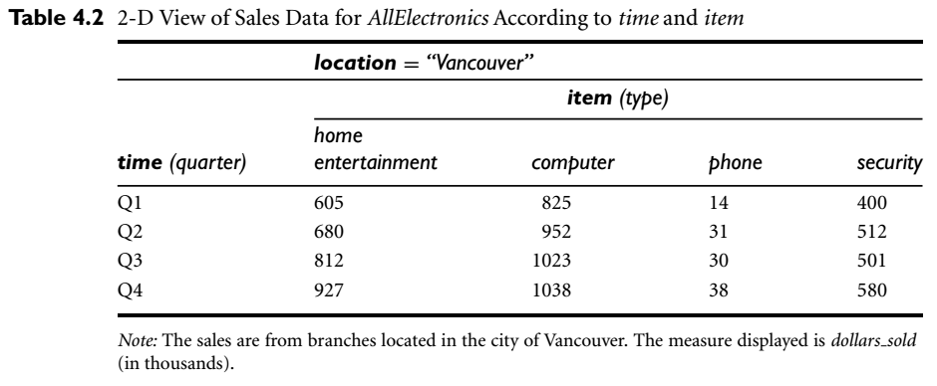
A 2D example of Allelectronics

Slide 34
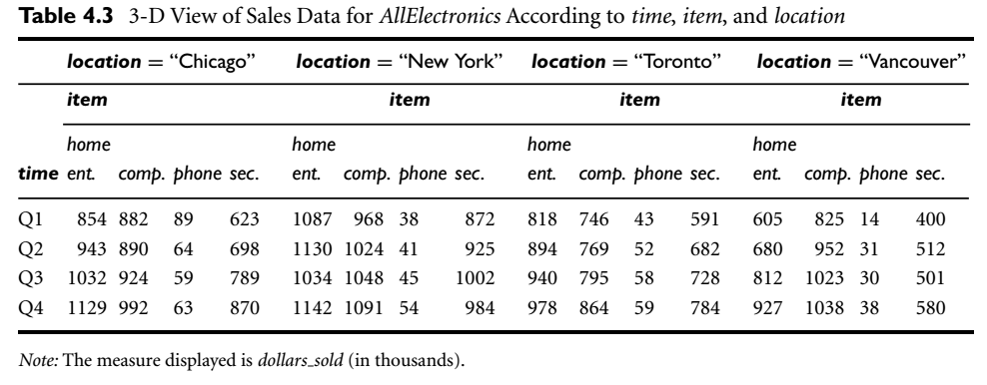
A 3D example of Allelectronics

Slide 35
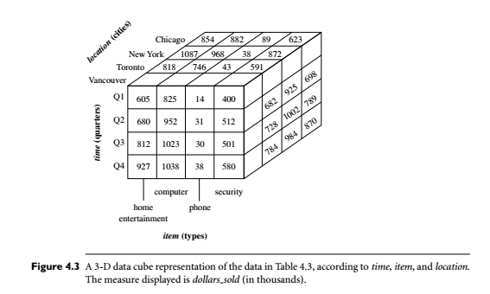
3D data cube

Slide 36
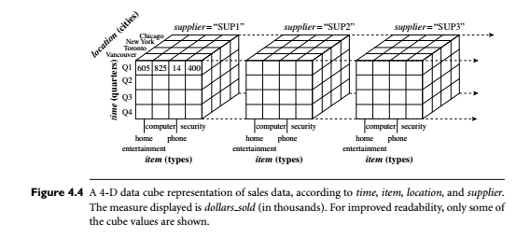
4D Data cube

Slide 37
From Tables and Spreadsheets to Data Cubes
A data warehouse is based on a multidimensional data model which views data in the form of a data cube
A data cube, such as sales, allows data to be modeled and viewed in multiple dimensions
Dimension tables, such as item (item_name, brand, type), or time(day, week, month, quarter, year)
Fact table contains measures (such as dollars_sold) and keys to each of the related dimension tables
In data warehousing literature, an n-D base cube is called a base cuboid. The top most 0-D cuboid, which holds the highest-level of summarization, is called the apex cuboid. The lattice of cuboids forms a data cube.

Slide 38
Cube: A Lattice of Cuboids
all
0-D (apex) cuboid
time
item
location
supplier
1-D cuboids
time,location
item,location
location,supplier
time,item
2-D cuboids
time,supplier
item,supplier
time,location,supplier
3-D cuboids
time,item,location
time,item,supplier
item,location,supplier
4-D (base) cuboid
time, item, location, supplier

Slide 39
Conceptual Modeling of Data Warehouses
Modeling data warehouses: dimensions & measures
Star schema: A fact table in the middle connected to a set of dimension tables
Snowflake schema: A refinement of star schema where some dimensional hierarchy is normalized into a set of smaller dimension tables, forming a shape similar to snowflake.
Fact constellations: Multiple fact tables share dimension tables, viewed as a collection of stars, therefore called galaxy schema or fact constellation

Slide 40
Example of Star Schema
time
Time, Item, branch and location are attributes
time_key
day
day_of_the_week
month
quarter
year
item
item_key
item_name
brand
type
supplier_type
Sales Fact Table
time_key
item_key
branch_key
branch
location
location_key
branch_key
branch_name
branch_type
location_key
street
city
state_or_province
country
units_sold
dollars_sold
avg_sales
Measures

Slide 41
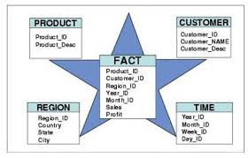
Example of Star Schema…
Each dimension consists of strictly one table.
It may produce some redundancy
Such as in above example see location table a state-or-province may have many cities.
So dimension table attributes may form a hierarch.

Slide 42
Example of Snowflake Schema
time
item
time_key
day
day_of_the_week
month
quarter
year
item_key
item_name
brand
type
supplier_key
supplier
Sales Fact Table
supplier_key
supplier_type
time_key
item_key
branch_key
branch
location
location_key
location_key
street
city_key
branch_key
branch_name
branch_type
units_sold
dollars_sold
city
city_key
city
state_or_province
country
avg_sales
Measures

Slide 43
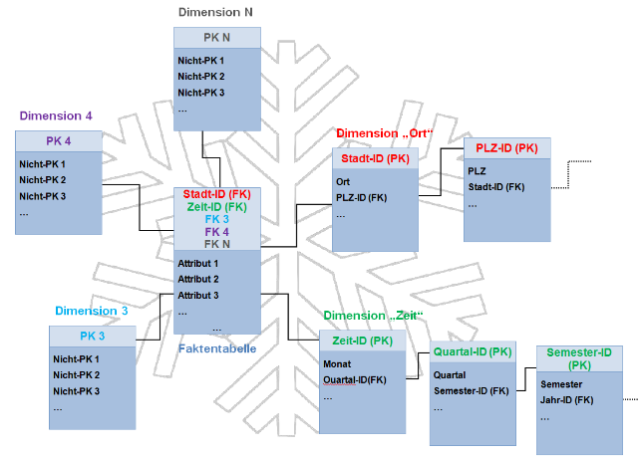
Normalized form so no redundancies
easy to maintain and saves storage space
snowflake structure can reduce the effectiveness of browsing, since more joins will be needed to execute a query.
System performance may be affected so that STAR is popular in Data warehousing.

Slide 44
Example of Fact Constellation
time
time_key
day
day_of_the_week
month
quarter
year
item
Shipping Fact Table
item_key
item_name
brand
type
supplier_type
Sales Fact Table
time_key
time_key
item_key
shipper_key
item_key
branch_key
from_location
branch
location_key
location
to_location
branch_key
branch_name
branch_type
units_sold
location_key
street
city
province_or_state
country
dollars_cost
dollars_sold
units_shipped
avg_sales
shipper
Measures
shipper_key
shipper_name
location_key
shipper_type

Slide 45
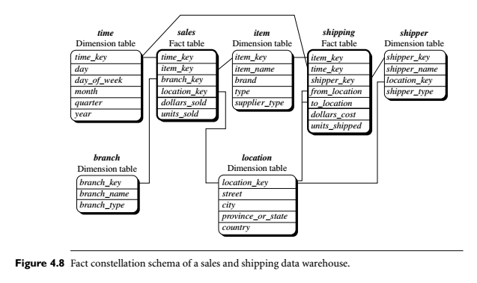
Example of Fact Constellation

Slide 46
Example of Fact Constellation
This schema specifies two fact tables, sales and shipping.
The sales table definition is identical to that of the star schema.
The shipping table has five dimensions, or keys
item key, time key, shipper key, from location, and to location
Also have two measures
dollars cost and units shipped.
It allow sharing of dimensions in fact tables.
Like item, time and location dimension are shared by both fact tables.

Slide 47
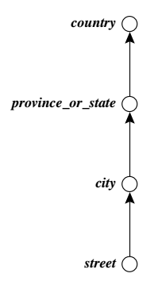
Role of Concept Hierarchy
A concept hierarchy defines a sequence of mappings from a set of low-level concepts to higher-level, more general concepts.
Street can be mapped into cities
City can be mapped into province_or_state
province_or_state can be mapped into country

Slide 48
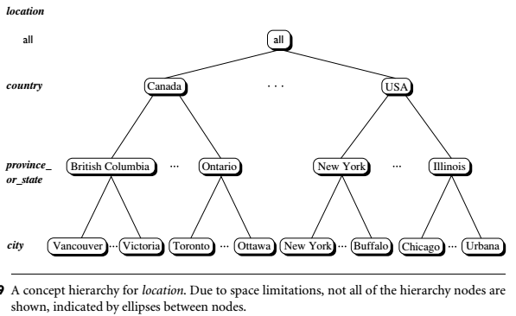
A Concept Hierarchy: Dimension (location)

Slide 49
A Concept Hierarchy: Dimension (location)
all
all
region
Europe
...
North_America
country
Germany
...
Spain
Canada
...
Mexico
city
Frankfurt
...
Vancouver
...
Toronto
office
L. Chan
...
M. Wind

Slide 50
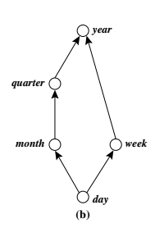
the attributes of a dimension may be organized in a partial order, forming a lattice
An example of a partial order for the time dimension based on the attributes day, week, month, quarter, and year is
“day < {month < quarter; week} < year.”
A concept hierarchy that is a total or partial order among attributes in a database schema is called a schema hierarchy.

Slide 51
Data Cube Measures: Three Categories
Distributive: if the result derived by applying the function to n aggregate values is the same as that derived by applying the function on all the data without partitioning
E.g., count(), sum(), min(), max()
Algebraic: if it can be computed by an algebraic function with M arguments (where M is a bounded integer), each of which is obtained by applying a distributive aggregate function
E.g., avg(), min_N(), standard_deviation()
Holistic: if there is no constant bound on the storage size needed to describe a subaggregate.
E.g., median(), mode(), rank()

Slide 52
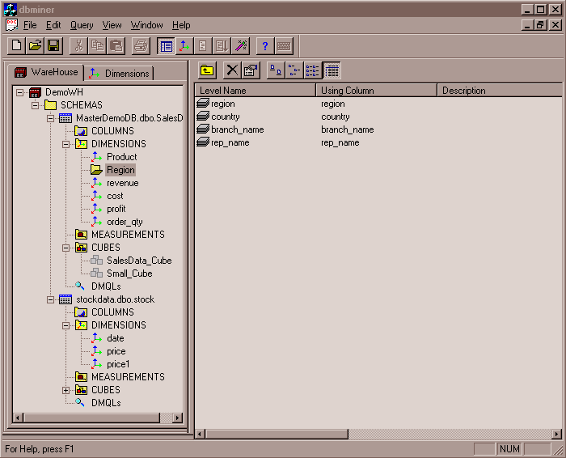
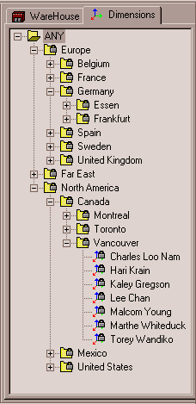
View of Warehouses and Hierarchies
Specification of hierarchies
Schema hierarchy
day < {month < quarter; week} < year
Set_grouping hierarchy
{1..10} < inexpensive

Slide 53
Multidimensional Data
Sales volume as a function of product, month, and region
Dimensions: Product, Location, Time
Hierarchical summarization paths
Region
Industry Region Year
Category Country Quarter
Product City Month Week
Office Day
Product
Month

Slide 54
A Sample Data Cube
Date
Total annual sales
of TVs in U.S.A.
1Qtr
2Qtr
3Qtr
4Qtr
sum
Product
TV
PC
U.S.A
VCR
sum
Canada
Country
Mexico
sum
All, All, All

Slide 55
Cuboids Corresponding to the Cube
all
0-D (apex) cuboid
product
date
country
1-D cuboids
product,date
product,country
date, country
2-D cuboids
3-D (base) cuboid
product, date, country

Slide 56
Typical OLAP Operations
Roll up (drill-up): summarize data
by climbing up hierarchy or by dimension reduction
Drill down (roll down): reverse of roll-up
from higher level summary to lower level summary or detailed data, or introducing new dimensions
Slice and dice: project and select
Pivot (rotate):
reorient the cube, visualization, 3D to series of 2D planes
Other operations
drill across: involving (across) more than one fact table
drill through: through the bottom level of the cube to its back-end relational tables (using SQL)

Slide 57
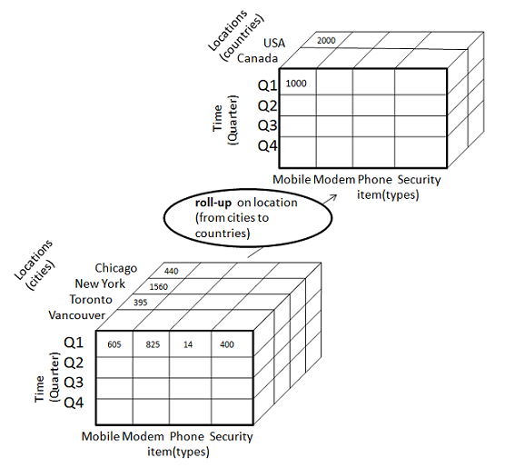
Roll-up OLAP operation
Roll up: (also called drill-up)
Its reduction of dimension like location, time
Also its known as climbing up a concept hierarchy for a dimension or dimension reduction.
Roll-up operation shows aggregation(sum) of the data.

Slide 58
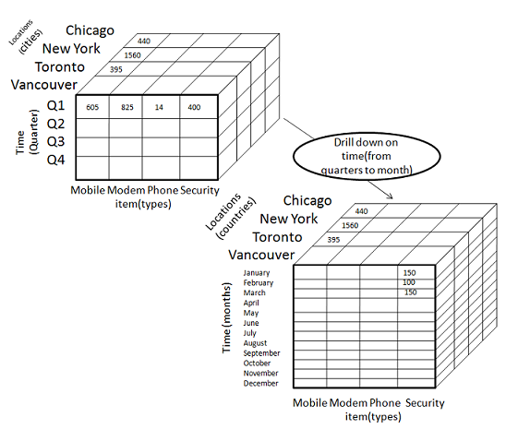
Roll-Down OLAP Operation
Drill-Down(Reverse operation than Drill-up)
It navigates from less detailed data to more detailed data.
Introduces additional dimensions like q1,q2,q3,q4 to 12 (Jan, Feb…Dec) months
Also its known as stepping-down a concept hierarchy for a dimension or introducing new dimension.

Slide 59
Slice and Dice
The slice operation performs a selection on one dimension of the given cube, resulting in a sub-cube.
Select dimension time using the criterion time D “Q1.”
The dice operation defines a sub-cube by performing a selection on two or more dimensions.
selection criteria that involve three dimensions:
(location D “Toronto” or “Vancouver”) and (time D “Q1” or “Q2”) and (item D “home entertainment” or “computer”).

Slide 60
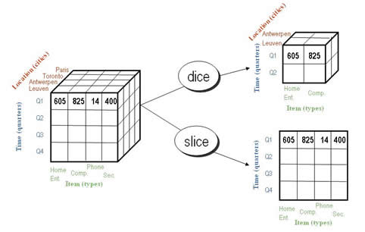

Slide 61
Pivot(Rotate)
is a visualization operation that rotates the data axes in view to provide an alternative data presentation.
shows a pivot operation where the item and location axes in a 2-D slice are rotated.
Other examples include rotating the axes in a 3-D cube.

Slide 62
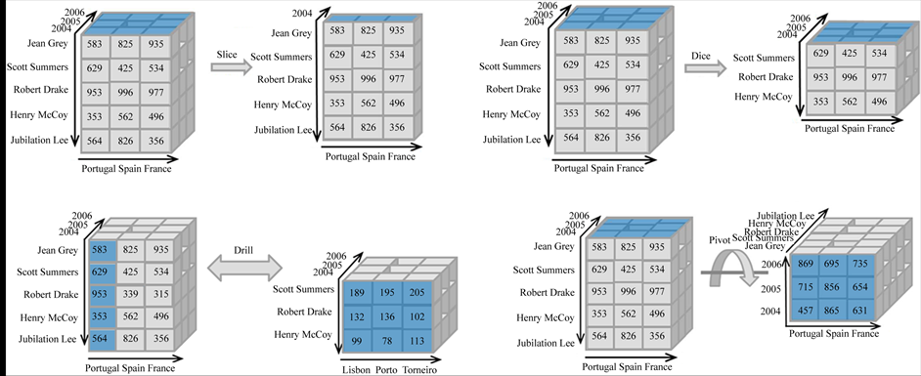

Slide 63
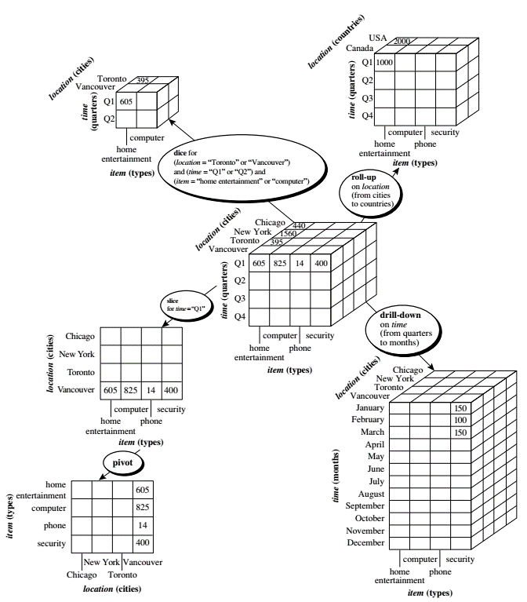

Slide 64
Lecture on Friday

Slide 65
A Star-Net Query Model
The querying of multidimensional databases can be based on a starnet model,
Which consists of radial lines emanating from a central point,
where each line represents a concept hierarchy for a dimension. Each abstraction level in the hierarchy is called a footprint.
These represent the granularities available for use by OLAP operations such as drill-down and roll-up.

Slide 66
A Star-Net Query Model
Customer Orders
Shipping Method
Customer
CONTRACTS
AIR-EXPRESS
ORDER
TRUCK
PRODUCT LINE
Time
Product
ANNUALY
QTRLY
DAILY
PRODUCT ITEM
PRODUCT GROUP
CITY
SALES PERSON
COUNTRY
DISTRICT
REGION
DIVISION
Location
Each circle is called a footprint
Promotion
Organization

Slide 67
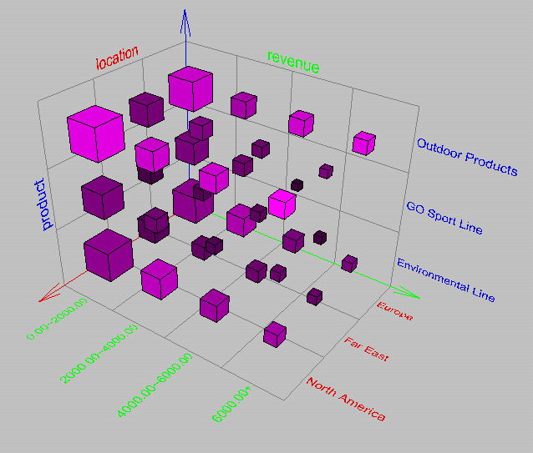
Browsing a Data Cube
Visualization
OLAP capabilities
Interactive manipulation

Slide 68
Chapter 4: Data Warehousing and On-line Analytical Processing
Data Warehouse: Basic Concepts
Data Warehouse Modeling: Data Cube and OLAP
Data Warehouse Design and Usage
Data Warehouse Implementation

Slide 69
Business Analysis gains from Warehouse
WH Can measure performance and perform adjustments to win over market competitors.
WH Can enhance business productivity, by quickly gathering information to describe organizations current state.
WH It supports customer relationship management, because it show customers and items across department and even all markets.
WH Cost reduction by tracking customer trends, patterns for long period with consistent and reliable manner.

Slide 70
WH design views
Suppose for a large and complex building structure the owner, architect and builder may have different views.
Similarly to design a WH may have different view to make it efficient and effective.
In this order we need to understand business needs and create a sustainable framework to design its WH.
A view can be
topdown view,
the data source view,
the data warehouse view, and
the business query view.

Slide 71
Design of Data Warehouse: A Business Analysis Framework
Four views regarding the design of a data warehouse
Top-down view
allows selection of the relevant information necessary for the data warehouse. This information matches current and future business needs.
Data source view
exposes the information being captured, stored, and managed by operational systems
Data warehouse view
consists of fact tables and dimension tables
Business query view
sees the perspectives of data in the warehouse from the view of end-user

Slide 72
WH Design
Building a warehouse is a complex task
It required business skills, technology skills, and programming skills.
Apart from all these skills warehouse involves how system stores and manages data.
How to build extractors, that transfers data from OLTP system to warehouse system
How to build warehouse refresh software to keep a warehouse up-to-date.

Slide 73
Data Warehouse Design Process
1. Top-down, bottom-up approaches or a combination of both
Top-down: Starts with overall design and planning (mature). It will be useful when the technology is mature and business processes are solved, clear and well understood.
Bottom-up: Starts with experiments and prototypes (rapid). It is useful in early stages of business modeling and technology development. Less expensive to get benefit.
Combination of both needed for rapid development.
2. From software engineering point of view
Waterfall: structured and systematic analysis at each step before proceeding to the next
Spiral: rapid generation of increasingly functional systems, short turn around time, quick turn around

Slide 74
Data Warehouse Design Process…
3. Typical data warehouse design process
Choose a business process to model, e.g., orders, invoices, etc.
Choose the grain (atomic level of data) of the business process e.g individual transaction
Choose the dimensions that will apply to each fact table record e.g time, item, customer, supplier n etc
Choose the measure that will populate each fact table record e.g dollars_sold or items_sold.

Slide 75
Data Warehouse Development: A Recommended Approach
Multi-Tier Data Warehouse
Distributed Data Marts
Enterprise Data Warehouse
Data Mart
Data Mart
Model refinement
Model refinement
Define a high-level corporate data model

Slide 76
Data Warehouse Usage
Three kinds of data warehouse applications
Information processing
supports querying, basic statistical analysis, and reporting using crosstabs, tables, charts and graphs
Analytical processing
multidimensional analysis of data warehouse data
supports basic OLAP operations, slice-dice, drilling, pivoting
Data mining
knowledge discovery from hidden patterns
supports associations, constructing analytical models, performing classification and prediction, and presenting the mining results using visualization tools

Slide 77
From On-Line Analytical Processing (OLAP) to On Line Analytical Mining (OLAM)
Why online analytical mining?
High quality of data in data warehouses
DW contains integrated, consistent, cleaned data
Available information processing structure surrounding data warehouses
ODBC, OLEDB, Web accessing, service facilities, reporting and OLAP tools
OLAP-based exploratory data analysis
Mining with drilling, dicing, pivoting, etc.
On-line selection of data mining functions
Integration and swapping of multiple mining functions, algorithms, and tasks
Notes:
Open Database Connectivity (ODBC) is an open standard application programming interface (API) for accessing a database. By using ODBC statements in a program, you can access files in a number of different databases, including Access, dBase, DB2, Excel, and Text.
OLE DB (Object Linking and Embedding, Database, sometimes written as OLEDB orOLE-DB), an API designed by Microsoft, allows accessing data from a variety of sources in a uniform manner. The API provides a set of interfaces implemented using the Component Object Model (COM); it is otherwise unrelated to OLE.

Slide 78
Chapter 4: Data Warehousing and On-line Analytical Processing
Data Warehouse: Basic Concepts
Data Warehouse Modeling: Data Cube and OLAP
Data Warehouse Design and Usage
Data Warehouse Implementation

Slide 79
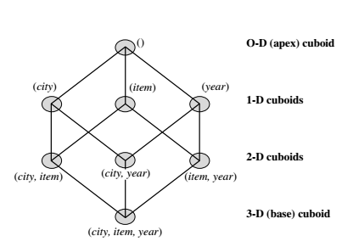
Lattice of cuboids, making up a 3-D data cube. Each cuboid represents a different group-by. The base cuboid contains city, item, and year dimensions.
At the core of multidimensional data analysis is the efficient computation of aggregations across many sets of dimensions.
In SQL terms, these aggregations are referred to as group-by’s.
Each group-by can be represented by a cuboid, where the set of group-by’s forms a lattice of cuboids defining a data cube.

Slide 80
Efficient Data Cube Computation
Data cube can be viewed as a lattice of cuboids
The bottom-most cuboid is the base cuboid
The top-most cuboid (apex) contains only one cell
How many cuboids in an n-dimensional cube with L levels?
Total number of Cuboids

Slide 81
Efficient Data Cube Computation
If the cube has 10 dimensions and each dimension has five levels (including all), the total number of cuboids that can be generated is 510 ≈ 9.8 × 106.
The size of each cuboid also depends on the cardinality (i.e., number of distinct values) of each dimension.
By now, you probably realize that it is unrealistic to precompute and materialize all of the cuboids that can possibly be generated for a data cube (i.e., from a base cuboid)
Materialization of data cube
Materialize every (cuboid) (full materialization), none (no materialization), or some (partial materialization)
Selection of which cuboids to materialize
Based on size, sharing, access frequency, etc.

Slide 82
Data cube materialization
There are three choices for data cube materialization given a base cuboid:
1. No materialization: Do not precompute any of the “nonbase” cuboids. This leads to computing expensive multidimensional aggregates on-the-fly, which can be extremely slow.
2. Full materialization: Precompute all of the cuboids. The resulting lattice of computed cuboids is referred to as the full cube. This choice typically requires huge amounts of memory space in order to store all of the precomputed cuboids.

Slide 83
Data cube materialization
3. Partial materialization: Selectively compute a proper subset of the whole set of possible cuboids.
Alternatively, we may compute a subset of the cube, which contains only those cells that satisfy some user-specified criterion, such as where the tuple count of each cell is above some threshold.
We will use the term subcube to refer to the latter case, where only some of the cells may be precomputed for various cuboids.
Partial materialization represents an interesting trade-off between storage space and response time.

Slide 84
The “Compute Cube” Operator
Cube definition and computation in DMQL
define cube sales [item, city, year]: sum (sales_in_dollars)
compute cube sales
Transform it into a SQL-like language (with a new operator cube by, introduced by Gray et al.’96)
SELECT item, city, year, SUM (amount)
FROM SALES
CUBE BY item, city, year
Need compute the following Group-Bys
(date, product, customer),
(date,product),(date, customer), (product, customer),
(date), (product), (customer)
()
()
(city)
(item)
(year)
(city, item)
(city, year)
(item, year)
(city, item, year)
Notes:
The Data Mining Query Language (DMQL) was proposed by Han, Fu, Wang, et al. for the DBMiner data mining system. The Data Mining Query Language is actually based on the Structured Query Language (SQL). Data Mining Query Languages can be designed to support ad hoc and interactive data mining.

Slide 85
bitmap indexing and join indexing
during load and refresh, the materialized cuboids should be updated efficiently. Parallelism and incremental update techniques for this operation should be explored.
To facilitate efficient data accessing, most data warehouse systems support index structures and materialized views (using cuboids).
General methods to select cuboids for materialization were discussed earlier
Now we examine how to index OLAP data by bitmap indexing and join indexing

Slide 86
Indexing OLAP Data: Bitmap Index
Indexing allow quick searching in cubes
Index on a particular column
Each value in the column has a bit vector: bit-op is fast
The length of the bit vector: number of records in the base table
The i-th bit is set if the i-th row of the base table has the value for the indexed column
not suitable for high cardinality (# of distinct values in a column e.g region have 3) domains
A recent bit compression technique, Word-Aligned Hybrid (WAH), makes it work for high cardinality domain as well [Wu, et al. TODS’06]
Base table
Index on Region
Index on Type

Slide 87
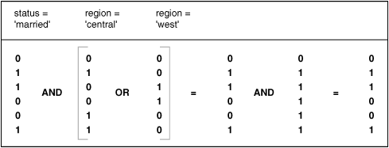
Its easier to make queries in bitmap indexing

Slide 88
Advantages of bitmap indexing
Bitmap indexing is advantageous compared to hash and tree indices.
It is especially useful for low-cardinality domains because comparison, join, and aggregation operations are then reduced to bit arithmetic, which substantially reduces the processing time.
Bitmap indexing leads to significant reductions in space and input/output (I/O) since a string of characters can be represented by a single bit.
For higher-cardinality domains, the method can be adapted using compression techniques.

Slide 89
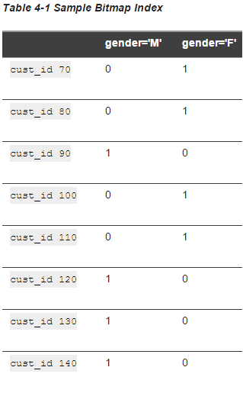
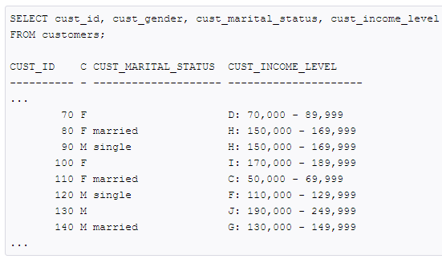
Indexing OLAP Data: Join Indices

Slide 90
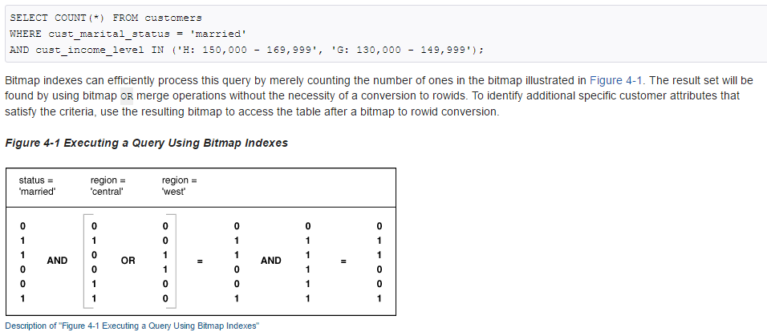

Slide 91
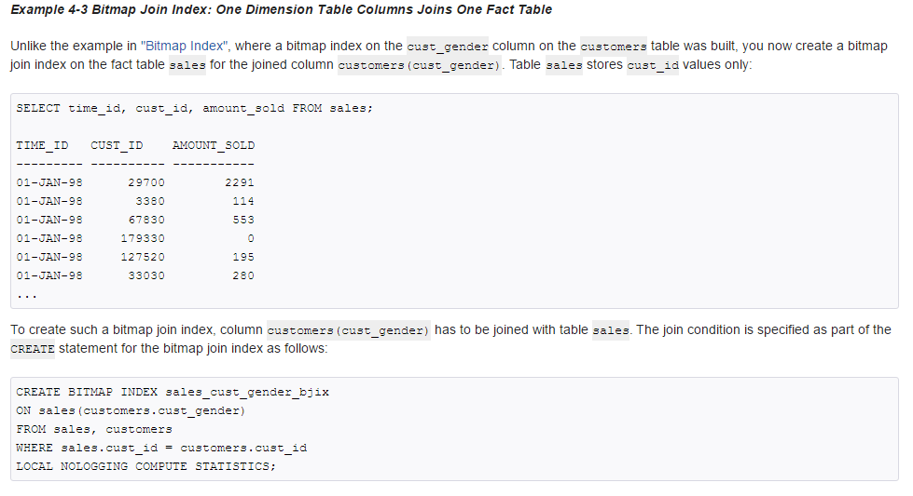
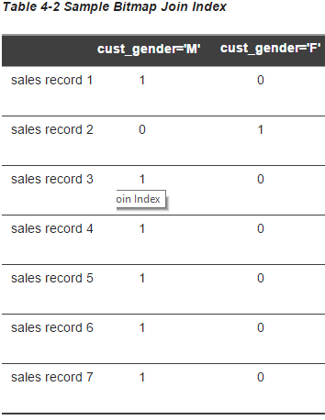
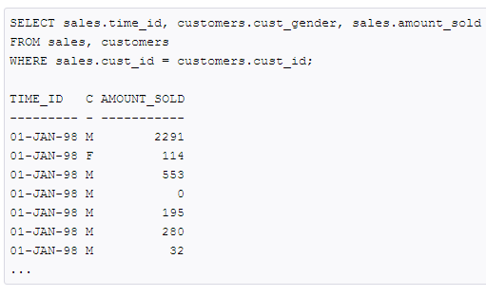

Slide 92
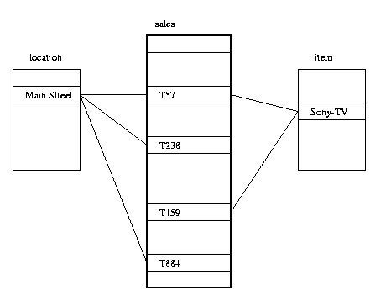
Indexing OLAP Data: Join Indices
Join index: JI(R-id, S-id) where R (R-id, …)  S (S-id, …)
Traditional indices map the values to a list of record ids
It materializes relational join in JI file and speeds up relational join
In data warehouses, join index relates the values of the dimensions of a start schema to rows in the fact table.
E.g. fact table: Sales and two dimensions city and product
A join index on city maintains for each distinct city a list of R-IDs of the tuples recording the Sales in the city
Join indices can span multiple dimensions

Slide 93
Efficient Processing OLAP Queries
The purpose of materializing cuboids and constructing OLAP index structures is to speed up query processing in data cubes. Given materialized views, query processing should proceed as follows:
Determine which operations should be performed on the available cuboids
Transform drill, roll, etc. into corresponding SQL and/or OLAP operations, e.g., dice = selection + projection
Determine which materialized cuboid(s) should be selected for OLAP operations
Let the query to be processed be on {brand, province_or_state} with the condition “year = 2004”, and there are 4 materialized cuboids available:
1) {year, item_name, city}
2) {year, brand, country}
3) {year, brand, province_or_state}
4) {item_name, province_or_state}, where year = 2004
Which should be selected to process the query?
Explore indexing structures and compressed vs. dense array structs in MOLAP

Slide 94
OLAP Server Architectures
Implementations of a warehouse server for OLAP processing include: ROLAP, MOLAP,HOLAP servers
Relational OLAP (ROLAP) servers:
These are the intermediate servers that stand in between a relational back-end server and client front-end tools.
Use relational or extended-relational DBMS to store and manage warehouse data and OLAP middle ware
Include optimization of DBMS backend, implementation of aggregation navigation logic, and additional tools and services
Greater scalability than MOLAP

Slide 95
OLAP Server Architectures…
Multidimensional OLAP (MOLAP) servers:
These servers support multidimensional data views through array-based multidimensional storage engines.
They map multidimensional views directly to data cube array structures.
The advantage of using a data cube is that it allows fast indexing to precomputed summarized data.
Notice that with multidimensional data stores, the storage utilization may be low if the dataset is sparse.

Slide 96
OLAP Server Architectures…
Hybrid OLAP (HOLAP) servers:
The hybrid OLAP approach combines ROLAP and MOLAP technology, benefiting from the greater scalability of ROLAP and the faster computation of MOLAP.
For example, a HOLAP server may allow large volumes of detailed data to be stored in a relational database, while aggregations are kept in a separate MOLAP store.
The Microsoft SQL Server 2000 supports a hybrid OLAP server.

Slide 97
OLAP Server Architectures…
Specialized SQL servers: (e.g., Redbricks)
To meet the growing demand of OLAP processing in relational databases, some database system vendors implement specialized SQL servers that provide advanced query language and query processing support for SQL queries over star and snowflake schemas in a read-only environment.

